Slide 1
ENGR 101 Introduction to Programming Week 1

Slide 2
Why am I in this class?
You want to be an Engineer?
→ You need ‘Problem solving skills’
formulate a problem, and
find creative solutions to solve it clearly
Why Python? – easy to read, easy to learn compared to other languages
anyone coded in C, C++, Java?

Slide 3

Why am I in this class?

Slide 4
What does it take to be successful in this class?

Slide 5
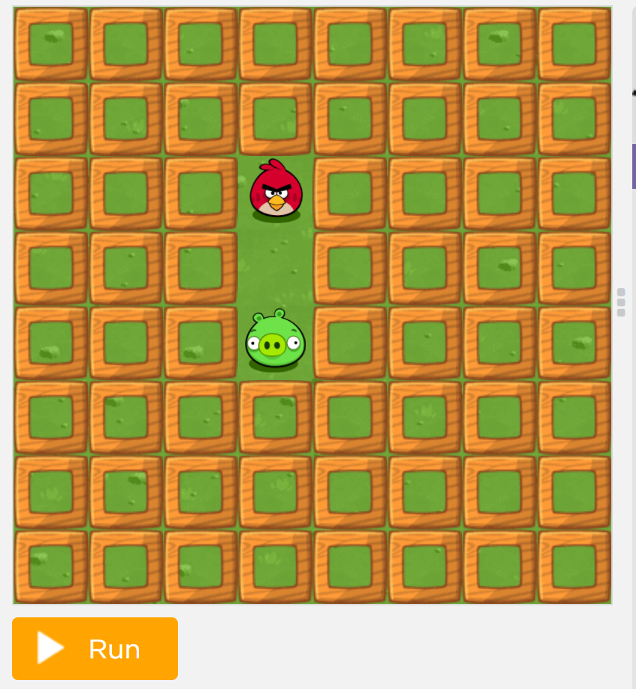
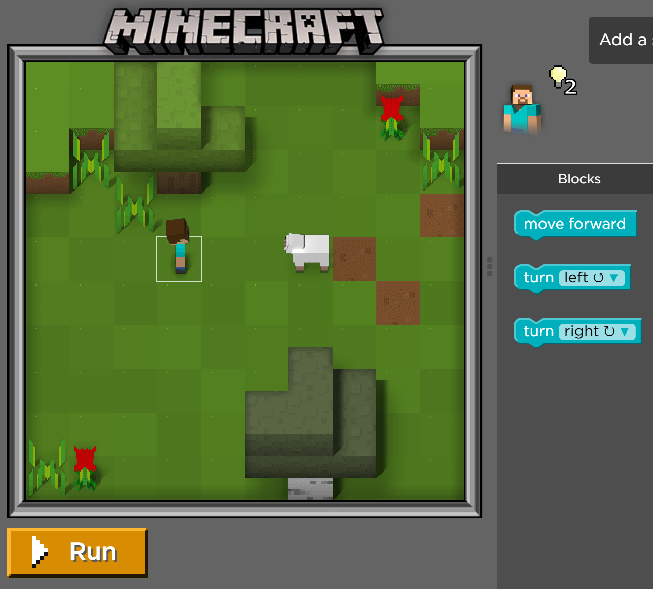
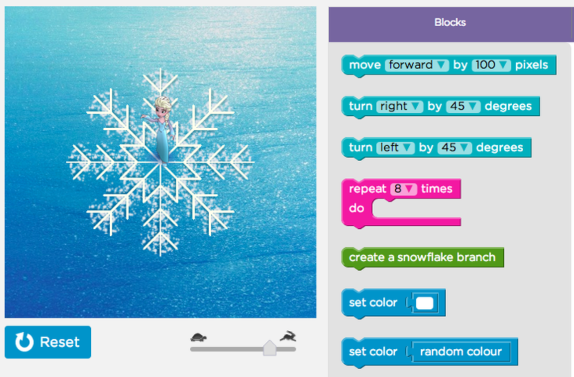
Course Content
Programming concepts
Python programming language
Fun (Games)
Art!
And, some challenges!

Slide 6
Course Organization
Syllabus to be updated and posted on LMS

Slide 7
Programming
Instructing a computer to do a set of commands as defined by the programmer:
Doing maths
Checking conditions
Getting input from the user
Writing into a file
Sending data to another email
Painting a certain region on the screen
etc.

Slide 8
Programming Languages
High-level programming languages.
e.g., C,C++,Perl, Java, Python
Low-level programming languages.
e.g., assembly languages
Machine coding
Differences?
High level programming easier, close to be interpreted by human language
Low level programming close to binary computer coding

Slide 9

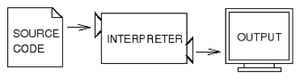
Compiler, Interpreter
You type the code – source code
Compiler translates it to byte code – (faster to run)
Interpreter reads your source code, and executes it (performs computations) line by line.

Slide 10
What’s a program?
input
output
math
conditional execution
repetition
...

Slide 11
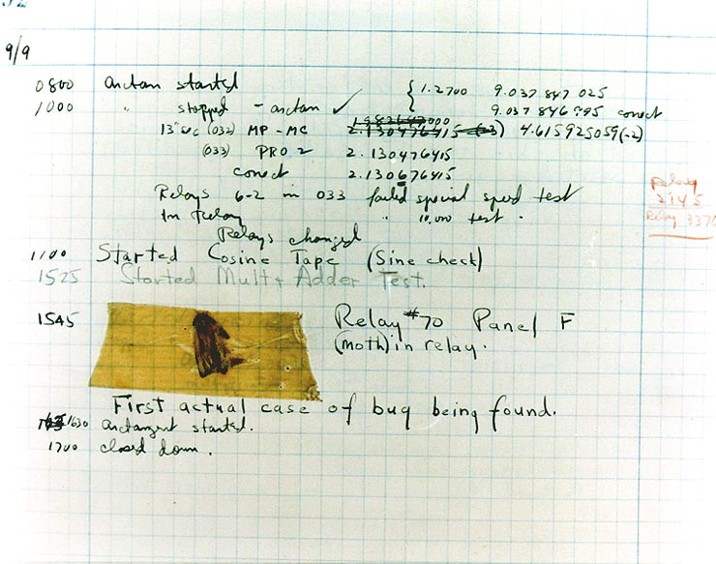
What’s debugging?
You will make mistakes for sure.
Programming errors are called bugs.
The process of tracking them down is called debugging.

Slide 12
Types of errors
Syntax errors: syntax refers to the structure of the program, and rules about that structure. Programs cannot be executed with wrong syntax.
E.g. (1+2) is correct
8) , syntax error
Runtime errors: errors that occur while the program is running. Also called exceptions.
Semantic errors: the program will not generate any error messages, but the output of the program is wrong.
Check the logic of your program!

Slide 13
Python Installation
Python can be downloaded at:
http://python.org (version 2.7)
Comes pre-installed on Mac and Linux!
PyCharm can be downloaded at:
http://www.jetbrains.com/pycharm/download/
License for Professional Edition is available

Slide 14
First program
Write a program that prints “Hello, World!”
Make some mistakes, and try again.

Slide 15
Exercise
If you run a 10 kilometer race in 43 minutes 30 seconds, what is your average time per mile? What is your average speed in miles per hour? (Hint: there are 1.61 kilometers in a mile).
>> Use Python interpreter as a calculator!

Slide 16
Exercise
If you run a 10 kilometer race in 43 minutes 30 seconds, what is your average time per mile? What is your average speed in miles per hour? (Hint: there are 1.61 kilometers in a mile).
>> Average time=(43*60+30) sec/(10/1.61)mile
=420.21 sec/mile
>> Average speed=(10/1.61) km/((43+30.0/60)/60)h
=8.567 sec/mile
Floating point division

Slide 17
Values and Types
Value → e.g., a number, a letter, text, etc.
Values have different types:
int e.g:1, 10
float e.g: 3.6, 4.0
str e.g.: “Hello”
bool e.g: True, False
etc.

Slide 18
Values and Types
type(‘Hello World’) str
type(17) int
type(3.2) float
type(’17’) str

Slide 19
Variables
A variable is a name that refers to a value.
Variables in your programming should have sensible and clear names:
e.g: num_students instead of x or var2
>>> message = ‘different’
>>> n = 17
>>> pi = 3.1415926535897931
use print to display the value of a variable.

Slide 20
Variable names and keywords
Variable names can be arbitrarily long.
Variable names should be meaningful for consistent and trackable programming.
Names can contain both letters and numbers.
Underscore (_) character can appear in a name.
Variable names cannot start with a number.
Don’t use Python reserved keywords (e.g. class, break, return etc.) as variable names.

Slide 21
Modes of the interpreter
Two modes: interactive mode and script mode.
In interactive mode, you type Python programs and the interpreter prints the result.
The chevron, >>>, is the prompt the interpreter uses to indicate that it is ready.
Alternatively, you can store code in a file and use the interpreter to execute the contents of the file, which is called a script.
By convention, Python scripts have names that end with .py. To execute the script in a command window, you would type python xyz.py.

Slide 22
Interactive Mode vs. Script Mode
‘engr101’
course = ‘engr101’
course

Slide 23
Operators and Operands
Operators are special symbols that represent computations like addition and multiplication.
The values that the operator is applied to are called operands.
+,-,/,*,**

Slide 24
Operators and Operands
When both operands are integers, / is a floor division.
30/60=0 That may be not what we may!
If either operands is a floating-point number, the result is a float.
30.0/60=0.5

Slide 25
Expressions
An expression is a combination of values, variables, and operators.
A value by itself is an expression.
A variable by itself is an expression.
All below are expressions:
17
x
x+17

Slide 26
Statements
A statement is a unit of code that the Python interpreter can execute
Anything that makes a line or multiple lines of Python code.
Each expression is a statement as well.
3+5 # statement and expression
print 42 # statement
a=7 # statement

Slide 27
Order of Operations
When more than one operator appears in an expression, the order of evaluation depends on the rules of precedence.
P E M D A S: parentheses, exponentiation, multiplication & division, addition & subtraction.
2*(3-1) 4
(1+1)**(5-2) 8
2**1+1 3 not 4
3*1**3 3 not 27

Slide 28
String Operations
+ operation performs concatenation
‘a’ + ‘b’ gives ‘ab’
‘a’ * 3 gives ‘aaa’

Slide 29
Comments
Adding notes to your program to make it clear and easy to track
# this is a comment.
print a # this is another comment.
# here is a multi-line comment
"""
comment
comment
Comment
"""

Slide 30
Reading
Please read Chapters 1 and 2 from your textbook
Try to do the exercises at the end of each chapter to make sure that you understand the material
(This is only for self-study, and is not an assignment to be graded. However, it is strongly recommended, if you want to be successful in this class. You can always see me or your TAs during my and their office hours in case you have any questions).

